Slide 1
Eternal vigilance is the price of bayh-Dole
By
Joseph P. Allen
2014 AUTM Eastern Regional Meeting

Slide 2
Times are uncertain,emotions are running high and we’re in the cross fire (Hatfield Clan, licensed under public domain via Wikimedia)

Slide 3
We’re impacted by larger debates raging all around us
Are Americans participants in the economy or victims?
Does innovation lead to prosperity for average folks or just the elites?
Does the patent system promote or hinder innovation?
Should government or markets steer the economy?

Slide 4
While you may not notice them, the critics have their eyes on you

Slide 5
And they are prominently promoting their views
‘It's time for Congress to recalibrate Bayh–Dole. Profits and patents can be powerful incentives for scientists, businesspeople, and universities, but new and ongoing risks — including high prices that limit access to lifesaving technologies, reduced sharing of scientific data, marked shifts of focus from basic to applied research, and conflicts of interests for doctors and academic medical centers — should be mitigated or averted through revisions of the law. “ New England Journal of Medicine, Aug. 2013
“If tax dollars fund an important part of biomedical innovation, it is not altogether unreasonable for the government to exercise some degree of control over pricing excesses. Yet, no such measures are currently in effect.” Brookings Institution, Nov. 2012
“If universities issued more nonexclusive licenses of their products, there would be less need to rely on march-in rights. Even though non-exclusive licenses may bring lower royalty rates, they can be successful in helping bring to market essential therapeutic technologies.” Journal of the American Medical Assn. March, 2014

Slide 6
“Do university patents pay off?” Yale Journal of Law & Technology, June 2014
University patent programs earn a negative rate of return on high-tech patents.
University patent programs may harm professors’ ability to obtain research funding, to collaborate with other institutions, and to disseminate their work.
University patent programs are, at best, a modest benefit to professors seeking to commercialize high-tech academic research.
Fewer than half of university spinoff founders report that patents helped their commercialization efforts.

Slide 7
The beat goes on (and on and on…)
“There was no bigger disappointment to me than the failure to enact the Innovation Act. Trial lawyers, pharmaceutical manufacturers, and universities have been rightfully blamed as the entrenched interests that killed the bill while the tech community has been dubbed ‘D.C.’s biggest loser. ‘ “ Rep. Tom Marino, Vice Chair of the House IP Subcommittee, August 2014
“After all, while universities don’t engage in the most egregious troll tactics, universities’ efforts to generate licensing revenue have imposed significant costs on the public that aren’t so different from problems created by patent trolls.” Patent trolls have a surprising ally: universities, Washington Post, Nov. 30, 2013
“It is less, clear, however, whether this act has always been effective in directing public research into the public interest… Rather, it is quite possible that one unforeseen consequence of Bayh-Dole allows for modes of commercialization that have and (sic) inflationary effect on the whole healthcare system, not just new products.” Building an Innovation-Based Economy, Brookings Institution (Nov. 2012)

Slide 8
Most of the attacks are emotional, but emotion sells

Slide 9
This response to attacks doesn’t work very well (Gee, it seems so safe down here)

Slide 10
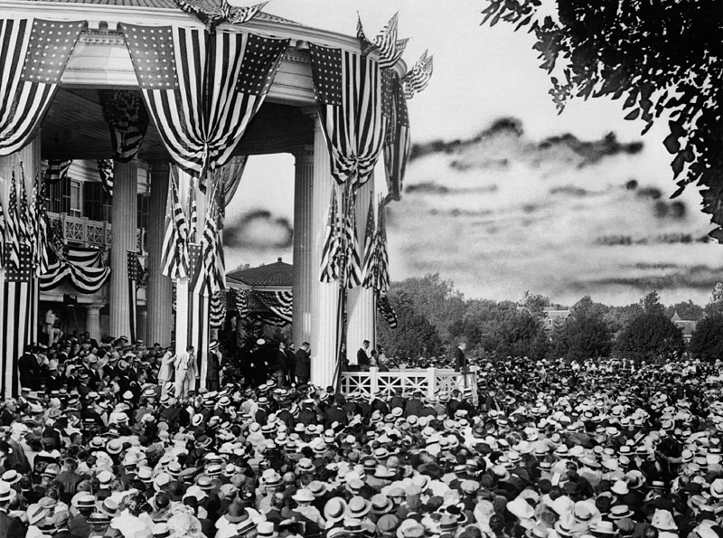
We have a good story to tell that will resonate with the public

Slide 11
We impact lives around the world… “Without your law, I wouldn’t be alive today.” Cancer survivor Betsy deParry hugs Sen. Bayh

Slide 12
And are an important part of the US economy
153 new drugs on market under Bayh-Dole-- zero before
Bayh-Dole contributed $863 BILLION to US gross industry output (‘96- ‘10)
Public sector drugs receive FDA “high priority reviews” at twice the rate of private sector or foreign drugs
10,000 new companies formed
Supported 3,000,000 US jobs between ‘96- ‘10
705 new startups in ‘12
2 companies formed every working day of the year
‘12 Sales of products worth twice federal Investment in university research

Slide 13
SO, What should you do?
Publicize your successes-- explain why they benefit the public
Visit your Congressional and state office holders (with Congressional relations)
Circulate articles to those outside the profession explaining what you do and why it’s important
Don’t permit slanderous attacks to take root, respond!

Slide 14
“Do not wait: the time will never be ‘just right.’ Start where you stand, and work with whatever tools you may have at your command, and better tools will be found as you go along. “ George Herbert

